Slide 1
ROLL CALL SYSTEM
DBMS Project
Group Members :
1. Anagha M B170660CS
2. Amritha Anil B170472CS
3. Gonuguntla Kavya B170722CS
4. Krishnapriya Santhosh B170881CS

Slide 2
INTRODUCTION
The​ ​ roll ​ call​ ​ system​ ​was implemented in our Ladies hostel to ensure the safety and security of girls students​ ​.​​We have successfully computerized this process.​ ​ ​

Slide 3
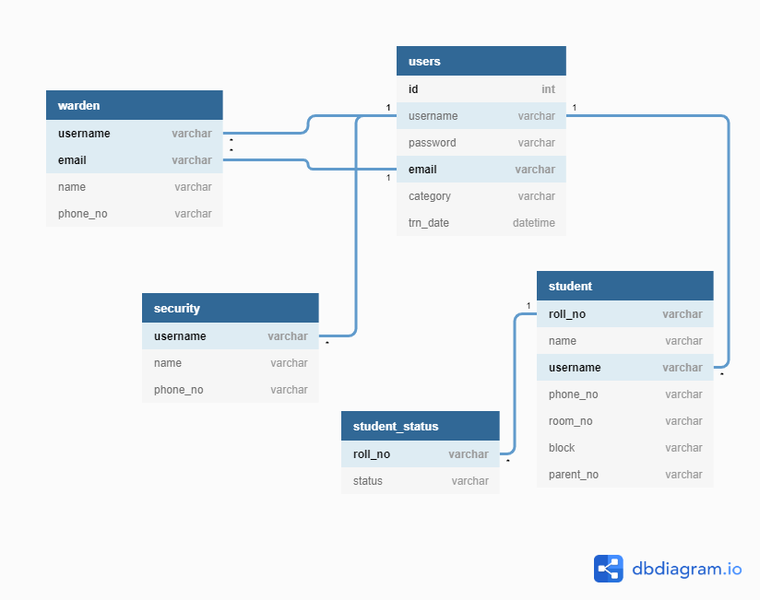

Slide 4
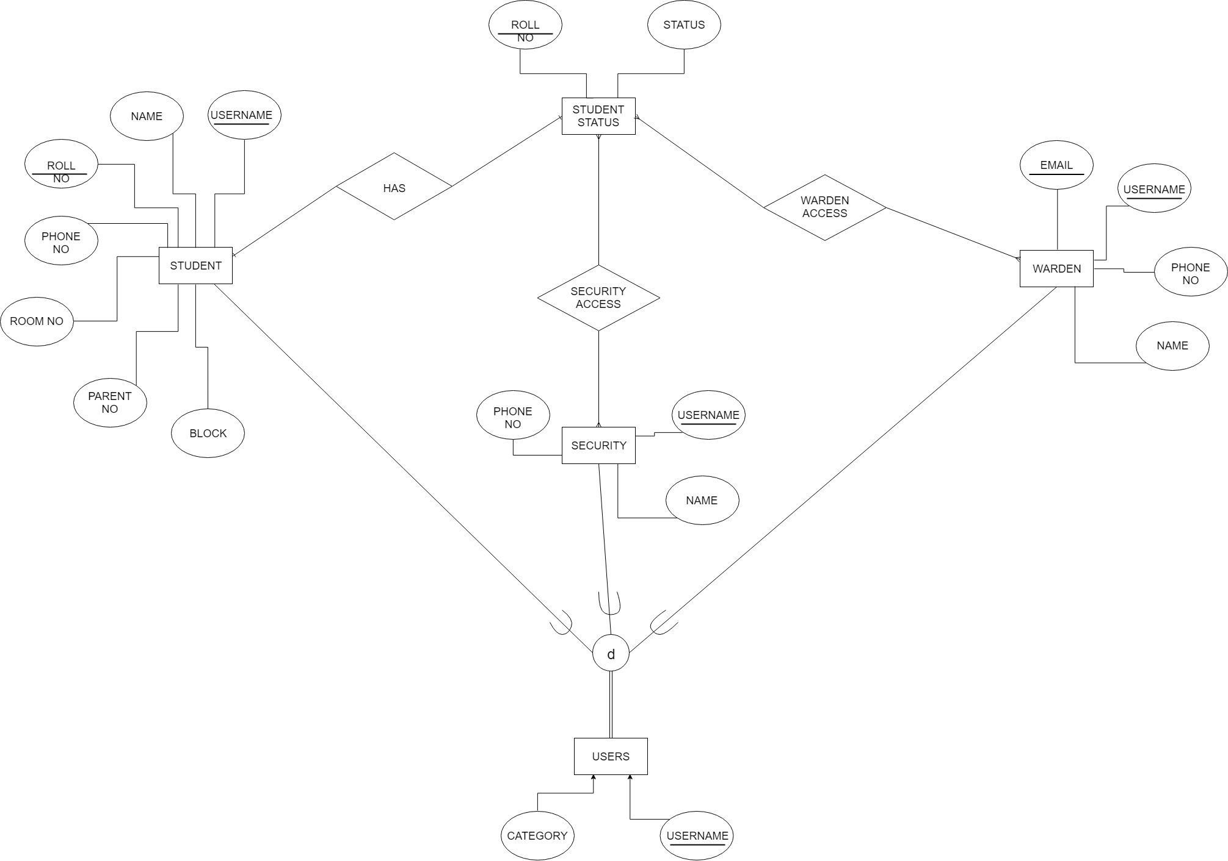
E-R Diagram

Slide 5
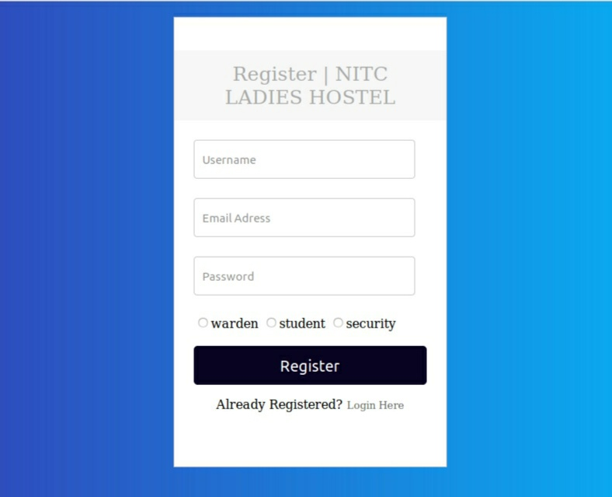
Registration Page

Slide 6
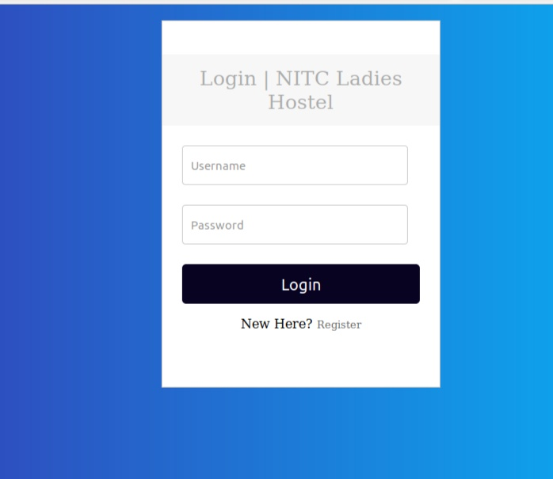
Login Page

Slide 7
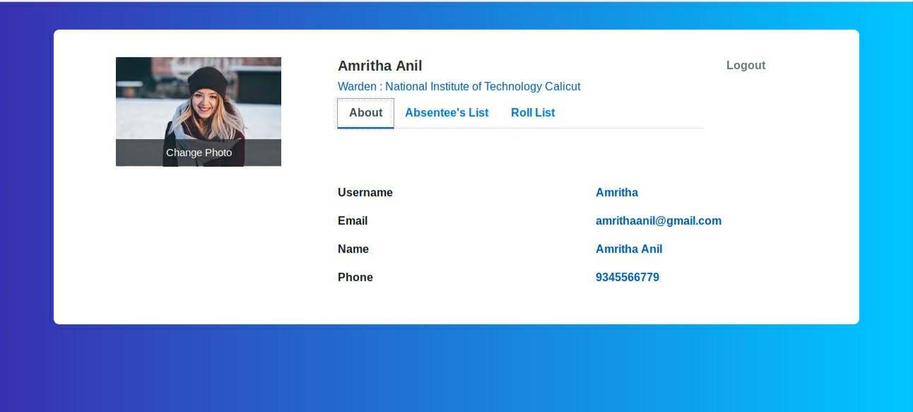
Warden Dash

Slide 8
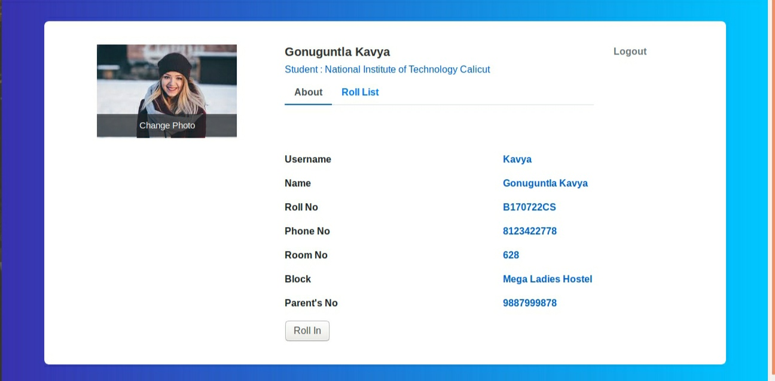
Student Dash

Slide 9
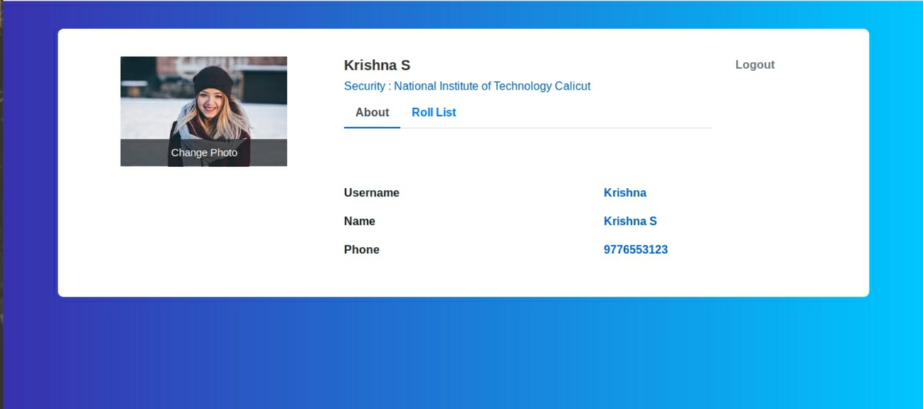
Security Dash

Slide 10
THANK YOU

